Slide 1
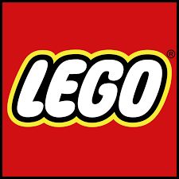
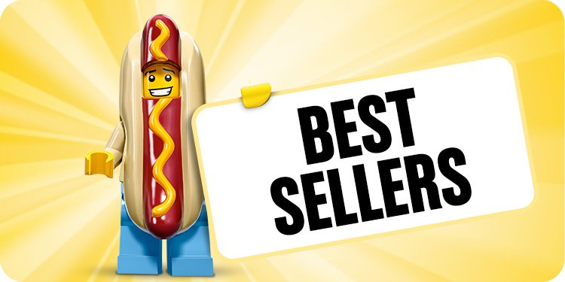
LEGO Co Distribution Chain
Name
Institution of affiliation
Notes:
LEGO Company is a company that is involved in the manufacture and distribution of children toys.
It has been in operation for more than 50 years.
The company headquarter is based in Billund, Denmark.

Slide 2
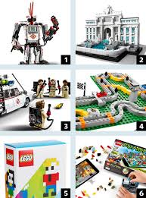
Options available for distribution
Having a central distributor from the head office from where the orders are received and processed.
Having chain of distributors in the various parts of the world who distribute for the company (Emmett & Crocker, 2016).
Outsourcing services of a logistics company which takes all the distribution responsibilities on behalf of the company.
Customers having to get the commodities from the various stores which distribute the company’s products near them (Christopher, 2016).
Setting up manufacturing plants in various towns around the world.
Notes:
The LEGO company for a long time has enjoyed the various options involved in the distribution of its products to the customers.
This means that being a monopoly in the toy industry, LEGO Co has to use all types of distribution options available to ensure that it meets the demands of its customers.
The options listed in the slide shows the wide variety of distribution chain that the company can use in meeting demands of the customers across the world.

Slide 3
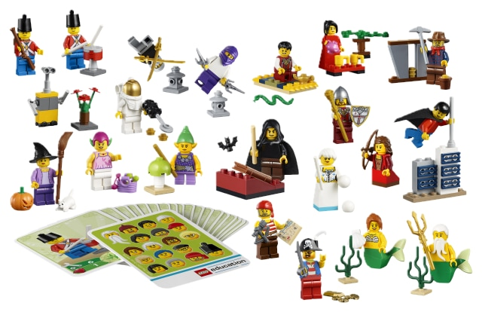
Newest And Most Socially Responsible Innovations In Distribution
Outsourcing of the distributors involved in the logistic and supply chain business (Aboutalebi, 2016).
Setting up of factory branches in the various towns involved in manufacturing of the company products.
Having a central distribution center that receives all the orders and services them (Hofmann & Knébel, 2016).
The new innovations are geared at ensuring that customer needs are responded to appropriately.
Notes:
Outsourcing of the supply chain and distribution services is where the company works with other companies like DHL in making sure that customers receive their orders.
The supply chain companies have the responsibility to ensure that the products get to the company after they have been disparched.
Any delays are blamed squarely on the distributor.
The company ahs been able to set manufacturing branches in order to serve the immediate needs of the customers near such places.
This allows customization of products supply by the company to the customers.

Slide 4
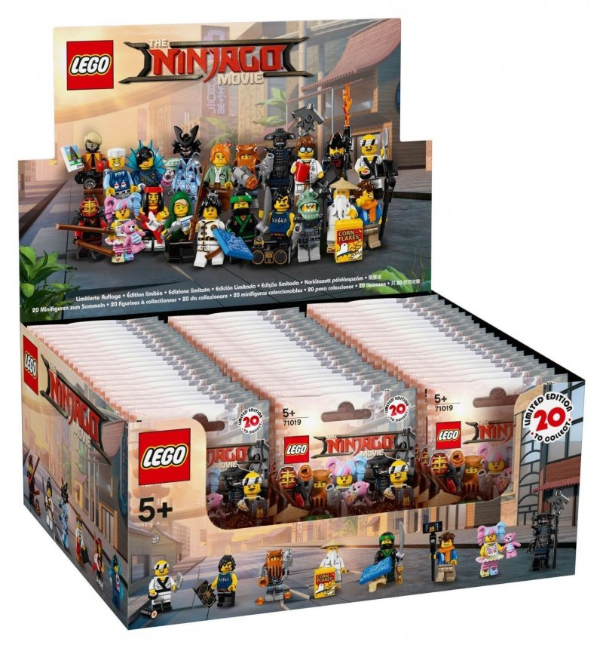
Application Of The New Innovations In Distribution In LEGO Co.
The new innovations will ensure that customer specifications are met by the company.
Reduction in the waiting time before the product is received by the consumer is also reduced (Christopher, 2016).
The prices of the company’s product is reduced making affordable to many people in need.
Customers are able to carry out inspection before the product is distributed to their destination.
Notes:
Innovations such as setting up manufacturing branches near the customers enable them to place their specifications when designing the product.
Setting up factories near the customers allows them to access the product with minimal distance hence reduces the time taken from placing and order and actual delivery of the product.
Since the local production is allowed, the prices reduces since there is little taxes and transport expenses for the customer.
Inspections are done by the customer because the actual delivery of the products and therefore their expectations are met.

Slide 5
References
Aboutalebi, R. (2016). Strategies for effective worldwide supply chains. Handbook of research on global supply chain management, 1-14.
Christopher, M. (2016). Logistics & supply chain management. Pearson UK.
Emmett, S., & Crocker, B. (2016). The relationship-driven supply chain: creating a culture of collaboration throughout the chain. CRC Press.
Hofmann, E., & Knébel, S. (2016). Supply Chain Differentiation: Background, Concept and Examples. Journal of Service Science and Management (JSSM), 9(2), 160-174.

